Slide 1
Curriculum for Wales Scheme of Learning: Humanities
7
Timeline Challenge

Slide 2
Department Vision
Overall Learning Journey 7-11 Overtime

Slide 3
Statements of What Matters
What matters statement 1: Enquiry, exploration and investigation inspire curiosity about the world, its past, present and future.​
The learners’ journey through this Area will encourage enquiry and discovery, as they are challenged to be curious and to question, to think critically and to reflect upon evidence. An enquiring mind stimulates new and creative thinking, through which learners can gain a deeper understanding of the concepts underpinning humanities, and their application in local, national and global contexts. Such thinking can help learners to understand human experiences and the natural world better.
What matters statement 4: Human societies are complex and diverse, and shaped by human actions and beliefs.​
An appreciation of identity, heritage and cynefin can influence learners emotionally and spiritually, and help build their sense of self and of belonging. Through an understanding of themselves, learners develop their own identity and an awareness of how they, as individuals, can shape the communities in which they live. Consequently, learners will come to realise that the choices we all make, individually and collectively, can have major impacts on society.
What matters Statement 2: Events and human experiences are complex, and are perceived, interpreted and represented in different ways
We encounter and make sense of the world though a variety of events and experiences. Humanities encourages learners to critically review the ways these events and experiences are perceived, interpreted and represented. As they form their own informed viewpoints and recognise those of others, learners can also develop self-awareness.

Slide 4
Four Purposes
Integral Skills
Ambitious, capable learners who: set themselves high standards and seek and enjoy challenge and are building up a body of knowledge with skills to connect and apply that knowledge in different contexts
Ethical, informed citizens who:
find, evaluate and use evidence in forming views and engage with contemporary issues based upon their knowledge and values and are knowledgeable about their culture, community, society and the world, now and in the past.
Healthy, confident individuals who:
are building their mental and emotional well-being by developing confidence, resilience empathy, and are ready to lead fulfilling lives as valued members of society.
Personal effectiveness - Encouraging teamwork and being a reliable contributor by organising and carrying out enquiries. Evaluating, justifying and expressing considered responses in a variety of ways
Creativity and innovation - Encouraging the presentation of information and findings in creative and innovative ways, and imagining possible futures based on the evidence.
Planning and organising - Encouraging the planning and organising of investigations, setting aims, objectives and success criteria, gathering and utilising a range of evidence, and reflecting on methods.
Critical thinking and problem-solving - Developing the ability to think analytically and understand the past and present as well as to imagine possible futures. purposes, e.g. to successfully describe, explain, persuade, discuss.
Cross Curricular Skills
Pedagogical Principles
Geography – Mapping
Science – Victorian inventions
English – WW1 Poetry
Drama - role plays
Literacy - describe and explain pit stop
Listening: I can listen to gain different people's views and ideas on various subjects, using them to arrive at my own conclusions.
Reading: I can distinguish between facts/evidence and bias/arguments.
I can summarise, synthesise and analyse information to gain in-depth understanding, e.g. of causes, consequences, patterns, using different sources.
Speaking: I can respond to others' points of view with confidence and sensitivity, summarising and evaluating what I have heard, read or seen.
Writing: I can use a range of connectives specifically when organising my ideas in whole texts for different purposes. I can adapt my writing style, choosing and using the best structures for different contexts and purposes, e.g. to successfully describe, explain, persuade, discuss.
Promote critical thinking: learners will work collaboratively to use various sources of evidence on their time period to prove how their time period impacted Wales.
Use A4L to accelerate progress: learners will have the opportunity to engage with the evidence and apply what they have found by teaching a lesson to the rest of the class proving how their time period had the greatest impact on Wales.
Make connections: learners should be able to make links between other subject areas and draw on knowledge to inform and improve their own work.
Build on previous knowledge: use their knowledge of primary and secondary sources and chronology to research and create a lesson that proves their time period had the greatest impact on Wales.
Create authentic contexts for learning: use local and Welsh examples of evidence to focus their time period on Wales.
Work collaboratively to agree a success criteria on what a good lesson should look like, prepare and deliver a lesson and record facts from each teams lessons.

Slide 5
Principles of Progression
Increasing effectiveness as a learner
Increasing breadth and depth of knowledge
Deepening understanding of the ideas and disciplines within Areas
Learners will have the opportunity to collaboratively research and analyse evidence on their chosen topic to prove how it had the greatest impact on Wales. They can ask increasingly sophisticated enquiry questions to form hypothesis and make predictions how their time period impacted Wales.
Learners have various opportunities to read and develop a breadth of knowledge looking at a range of books on their topic, and through online research.
Learners have the opportunity to further enhance how we organize time and where Wales fits on a timeline including significant events.
Learners can further apply new skills learned such as using primary and secondary sources, Interpreting what is in sources of evidence and making judgements on why their time period had an impact on Wales.
Looking at different types of evidence primary and secondary
Looking at chronology
Looking at different periods of time in History
Looking at change and continuity.
Looking at power and conflict.
Refinement and growing sophistication in the use and application of skills
Making connections and transferring learning into new contexts
Additional notes & Misconceptions
Discussion and evaluation of evidence and being able to make a collaborative judgment on how events have impacted Wales.
Being able to confidently lead and contribute to a collaborative project.
collaborative work to encourage understanding of evidence and change over time.
-Connections to other curriculum areas
English – poetry,
Languages French and German (Wars),
Drama role plays.
Science inventions.
Geography – mapping
Key aspect of this unit is to link learning from their primary school experience to secondary school.
This a project based approach with learner-led learning at the core allowing learner choice and autonomy over a long period of time with the teacher role as a facilitator.
This approach also allows a keen focus on how Wales was impacted by major world events and powers.

Slide 6
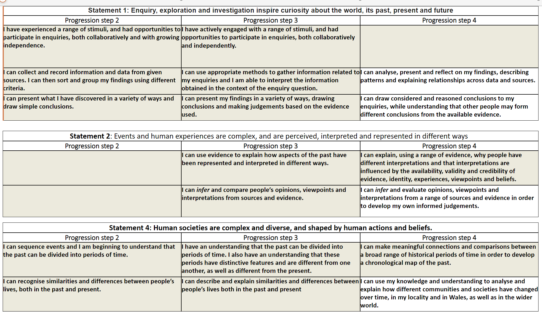
Progression Steps to inform teaching
Progression step 2
Progression step 3
Progression step 4

Slide 7
Prerequisite knowledge
How will skills be taught in this topic?
Skills neccessary in humanities have been shared with feeder primaries so that they can be addressed where pertinent in year 6.
The topics for this project have purposely been chosen to reflect those most done in the primary sector. The rationale here is for clear connections to content and building in more complex skills needed at secondary school.
​Collaborative work using primary and secondary evidence on a particular time period in Walesa HIstory.
Skills practiced and assessed would be Inferring, describing, explaining and making judgements on evidence.
Making connections & Authentic Contexts
This project focuses on how different time periods had the greatest impact on Wales with high expectations to have lots of local/Welsh examples in each groups research and final lessons.
EG - WW1 local war memorials and Shotton munition factory. WW2 – local bombings and national bombings in Swansea. Romans - buildings, roads, wars with the Welsh.
Key concepts & learning intentions
Learners should be grounded in an understanding of the identities, landscapes and histories that come together to form their cynefin.
To agree roles in groups and brainstorm what we know about a key time period our group will investigate.
To work collabratively to research a key time period and how it impacted Wales.
To teach a lesson that proves how a certain time period had an impact on Wales.
Key vocabulary
Cynefin
Primary and secondary evidence.
Artefacts, oral, pictoral and written types of evidence
Chronological order

