Slide 1
Curriculum for Wales Scheme of Learning: Humanities
7
The Normans

Slide 2
Department Vision
Overall Learning Journey 7-11 Overtime

Slide 3
Statements of What Matters
What matters statement 1: Enquiry, exploration and investigation inspire curiosity about the world, its past, present and future.​
The learners’ journey through this Area will encourage enquiry and discovery, as they are challenged to be curious and to question, to think critically and to reflect upon evidence. An enquiring mind stimulates new and creative thinking, through which learners can gain a deeper understanding of the concepts underpinning humanities, and their application in local, national and global contexts. Such thinking can help learners to understand human experiences and the natural world better.
What matters statement 4: Human societies are complex and diverse, and shaped by human actions and beliefs.​
An appreciation of identity, heritage and cynefin can influence learners emotionally and spiritually, and help build their sense of self and of belonging. Through an understanding of themselves, learners develop their own identity and an awareness of how they, as individuals, can shape the communities in which they live. Consequently, learners will come to realise that the choices we all make, individually and collectively, can have major impacts on society.
What matters Statement 2: Events and human experiences are complex, and are perceived, interpreted and represented in different ways
We encounter and make sense of the world though a variety of events and experiences. Humanities encourages learners to critically review the ways these events and experiences are perceived, interpreted and represented. As they form their own informed viewpoints and recognise those of others, learners can also develop self-awareness.

Slide 4
Four Purposes
Integral Skills
Ambitious, capable learners who: set themselves high standards and seek and enjoy challenge and are building up a body of knowledge with skills to connect and apply that knowledge in different contexts
Ethical, informed citizens who:
find, evaluate and use evidence in forming views and engage with contemporary issues based upon their knowledge and values and are knowledgeable about their culture, community, society and the world, now and in the past.
Healthy, confident individuals who:
are building their mental and emotional well-being by developing confidence, resilience empathy, and are ready to lead fulfilling lives as valued members of society.
Personal effectiveness - Encouraging teamwork and being a reliable contributor by organising and carrying out enquiries. Evaluating, justifying and expressing considered responses in a variety of ways
Creativity and innovation - Encouraging the presentation of information and findings in creative and innovative ways, and imagining possible futures based on the evidence.
Planning and organising - Encouraging the planning and organising of investigations, setting aims, objectives and success criteria, gathering and utilising a range of evidence, and reflecting on methods.
Critical thinking and problem-solving - Developing the ability to think analytically and understand the past and present as well as to imagine possible futures.
Cross Curricular Skills
Pedagogical Principles
L
Geography – Mapping
English – PEEL and explain question techniques
Expressive arts - role play, tapestry inference
iteracy
Listening: I can listen to gain different people's views and ideas on various subjects, using them to arrive at my own conclusions.
Reading: I can distinguish between facts/evidence and bias/arguments.
I can summarise, synthesise and analyse information to gain in-depth understanding, e.g. of causes, consequences, patterns, using different sources.
Speaking: I can respond to others' points of view with confidence and sensitivity, summarising and evaluating what I have heard, read or seen.
Writing: I can use a range of connectives specifically when organising my ideas in whole texts for different purposes. I can adapt my writing style, choosing and using the best structures for different contexts and purposes, e.g. to successfully describe, explain, persuade, discuss.
Promote critical thinking: learners will identify and evaluate who were the main contenders for the English throne. Learners will apply their knowledge and explain why the contenders wanted the throne.
Use A4L to accelerate progress: learners will have the opportunity to engage with evidence and evaluate the different strategies used in the key battles during this period.
Make connections: learners should be able to make links between other subject areas and draw on knowledge to inform and improve their own work.
Build on previous knowledge: use their knowledge of primary and secondary sources and chronology to evaluate why the Normans one the battle of Hastings.
Create authentic contexts for learning: use local and Welsh examples of evidence to focus on the impact the Normans had on Wales EG Feudalism, Castle building, Doomsday book.
Work collaboratively to decide where the best place is to build a castle and to apply the principles of the impact of the doomsday book on Wales.

Slide 5
Principles of Progression
Increasing effectiveness as a learner
Increasing breadth and depth of knowledge
Deepening understanding of the ideas and disciplines within Areas
Learners will have the opportunity to collaboratively analyse evidence on the Norman invasion of England and evaluate how the Norman conquest impacted Wales. They can ask increasingly sophisticated enquiry questions to form hypothesis on how the Normans defeated the Saxons. They can evaluate how Norman changes such as castles and the doomsday book impacted Wales.
Learners have various opportunities to evaluate primary source evidence and identify bias using sources such as the bayeux tapestry to find out what it tells us about the Norman Invasion.
Learners have the opportunity to critically analyse battle strategies working cooperatively to learn how the Normans won against the Saxons.
Learners can further apply new skills learned such as using primary and secondary sources, Interpreting what is in sources of evidence and making judgements on the Norman impact on Wales.
Looking at different types of evidence primary and secondary
Looking at chronology
Looking at bias in history
Looking at change and continuity.
Looking at power and conflict.
Learn how to explain and describe in History.
Refinement and growing sophistication in the use and application of skills
Making connections and transferring learning into new contexts
Additional notes & Misconceptions
Discussion of evidence to evaluate the usefulness of primary source evidence looking particularly at bias.
Learn how to describe and explain in History
Complete extended writing to judge how the Normans mostly impacted Wales.
--Connections to other curriculum areas
Expressive arts - bayeux tapestry
Drama – Normans role play summarising the main events of the Invasion
Key aspect of this unit is to look at change and continuity through the lens of the last great invasion of Britain.
This a mixture of teacher led and learner led learning that uses one of the greatest pictorial piece of evidence on British History the bayeux tapestry
This approach also allows learners to build on previous learning and show progress on essay writing in History.

Slide 6
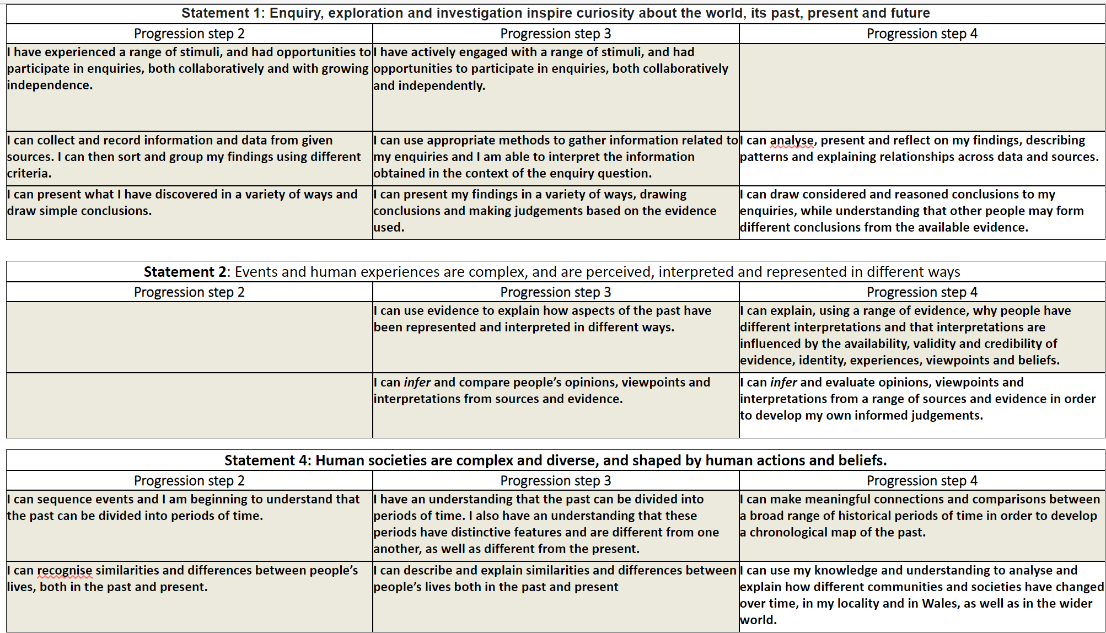
Progression Steps to inform teaching
Progression step 2
Progression step 3
Progression step 4

Slide 7
Prerequisite knowledge
How will skills be taught in this topic?
Some feeder primaries have touched on the Norman conquest and most have studied local castles.
Understanding how we study evidence in History EG primary and secondary evidence.
Understanding how we order time in History.
Strategies for developing extended writing.
​Skills developed will be Explain and Describe questions.
Source handling skills will be reliability of a source and the purpose of a source.
Further extended writing opportunity..
Making connections & Authentic Contexts
Local castle and doomsday book examples studied.
Introduction of taxation linked to current taxation.
Impact on language after Norman invasion.
Link with languages – French
PEEL skill linked to R.S and English.
Key concepts & learning intentions
To develop an understanding of who the 4 claimants to the English throne in 1066 were
To understand the course of events of key battles during the time of the Norman invasion including the Battle of Hastings.
To understand the impact William had on England.
To develop an understanding of why the Normans failed to conquer Wales
To understand the different changes William brought to Wales after he conquered England including castles, feudalism and taxation.
Key vocabulary
Cynefin
Primary and secondary evidence.
Conquered,
Motte and Bailey Castles,
Doomsday Book,
Feudalism.
Chronological order

