Slide 1
Curriculum for Wales Scheme of Learning: Humanities
7
Otzi the Ice Man

Slide 2
Department Vision
Overall Learning Journey 7-11 Overtime

Slide 3
Statements of What Matters
What matters statement 1: Enquiry, exploration and investigation inspire curiosity about the world, its past, present and future.​
The learners’ journey through this Area will encourage enquiry and discovery, as they are challenged to be curious and to question, to think critically and to reflect upon evidence. An enquiring mind stimulates new and creative thinking, through which learners can gain a deeper understanding of the concepts underpinning humanities, and their application in local, national and global contexts. Such thinking can help learners to understand human experiences and the natural world better.
What matters statement 4: Human societies are complex and diverse, and shaped by human actions and beliefs.​
An appreciation of identity, heritage and cynefin can influence learners emotionally and spiritually, and help build their sense of self and of belonging. Through an understanding of themselves, learners develop their own identity and an awareness of how they, as individuals, can shape the communities in which they live. Consequently, learners will come to realise that the choices we all make, individually and collectively, can have major impacts on society.

Slide 4
Four Purposes
Integral Skills
Ambitious, capable learners who: set themselves high standards and seek and enjoy challenge and are building up a body of knowledge with skills to connect and apply that knowledge in different contexts ​
​
Ethical, informed citizens who: ​
find, evaluate and use evidence in forming views and engage with contemporary issues based upon their knowledge and values and are knowledgeable about their culture, community, society and the world, now and in the past
Personal effectiveness - Encouraging teamwork and being a reliable contributor by organising and carrying out enquiries. Evaluating, justifying and expressing considered responses in a variety of ways
Creativity and innovation - Encouraging the presentation of information and findings in creative and innovative ways, and imagining possible futures based on the evidence.
Planning and organising - Encouraging the planning and organising of investigations, setting aims, objectives and success criteria, gathering and utilising a range of evidence, and reflecting on methods.
Critical thinking and problem-solving - Developing the ability to think analytically and understand the past and present as well as to imagine possible futures.
Cross Curricular Skills
Pedagogical Principles
Geography – where in the world and mountainous regions
Construction – making bronze and woodwork
English – extended writing PEEL
Listening: I can listen to gain different people's views and ideas on various subjects, using them to arrive at my own conclusions.
Reading: I can distinguish between facts/evidence and bias/arguments.
I can summarise, synthesise and analyse information to gain in-depth understanding, e.g. of causes, consequences, patterns, using different sources.
Speaking: I can respond to others' points of view with confidence and sensitivity, summarising and evaluating what I have heard, read or seen.
Writing: I can use a range of connectives specifically when organising my ideas in whole texts for different purposes. I can adapt my writing style, choosing and using the best structures for different contexts and purposes, e.g. to successfully describe, explain, persuade, discuss.
Promote critical thinking: learners will work collaboratively to use various sources of evidence on Oitzi the Ice man to make enquiry questions, form hypothesis and reach conclusions on what may have happened.
Use A4L to accelerate progress: learners will have the opportunity to engage with the evidence and apply what they have found to a timeline and recognize where Welsh History sits with this timeline. They will also have the opportunity to apply their understanding of the importance of Oitzi the Ice man to historians today in the form of an extended piece of writing.
Make connections: learners should be able to make links between other subject areas and draw on knowledge to inform and improve their own work.
Build on previous knowledge: use their knowledge of different time periods in History and connect with where Wales fits into this.
Create authentic contexts for learning: use local and Welsh examples of evidence to enhance discussions on types of evidence. Use the school timeline to understand how we order time and where Wales fits into chronology.

Slide 5
Principles of Progression
Increasing effectiveness as a learner
Increasing breadth and depth of knowledge
Deepening understanding of the ideas and disciplines within Areas
Learners will have the opportunity to collaboratively analyse evidence on and ask increasing sophisticated enquiry questions to form hypothesis and make predictions that form a narrative on the cynefin project and who Oitzi the Ice man was.
Learners
Learners have various opportunities to read and develop a breadth of knowledge looking at a range of evidence, a documentary and PPT slides.
Learners have the opportunity to understand how we organize time and how sophisticated humans have been over time in craftsmanship.
Learners can apply new skills learned such as using primary and secondary sources, Interpreting what is in sources of evidence and making judgements on why Oitzi the Ice Man is useful to Historians.
Looking at different types of evidence primary and secondary
Looking at chronology
Looking at different periods of time in History
Looking at change and continuity.
Refinement and growing sophistication in the use and application of skills
Making connections and transferring learning into new contexts
Additional notes & Misconceptions
Discussion and evaluation of evidence and being able to make a judgment in the form of a conclusion in an extended writing piece.
collaborative work to encourage understanding of evidence and change over time.
-Connections to other curriculum areas (Geography geopolitics, English, construction) and links are encouraged to be identified with learners.
-Links to significant Welsh men and women when looking at timelines.
- Oracy and extended writing links to a range of other subjects including R.S and English using PEEL.
Key Skills learners first come into contact with are
Evaluating the usefulness of evidence
Extended writing in History (essay)

Slide 6
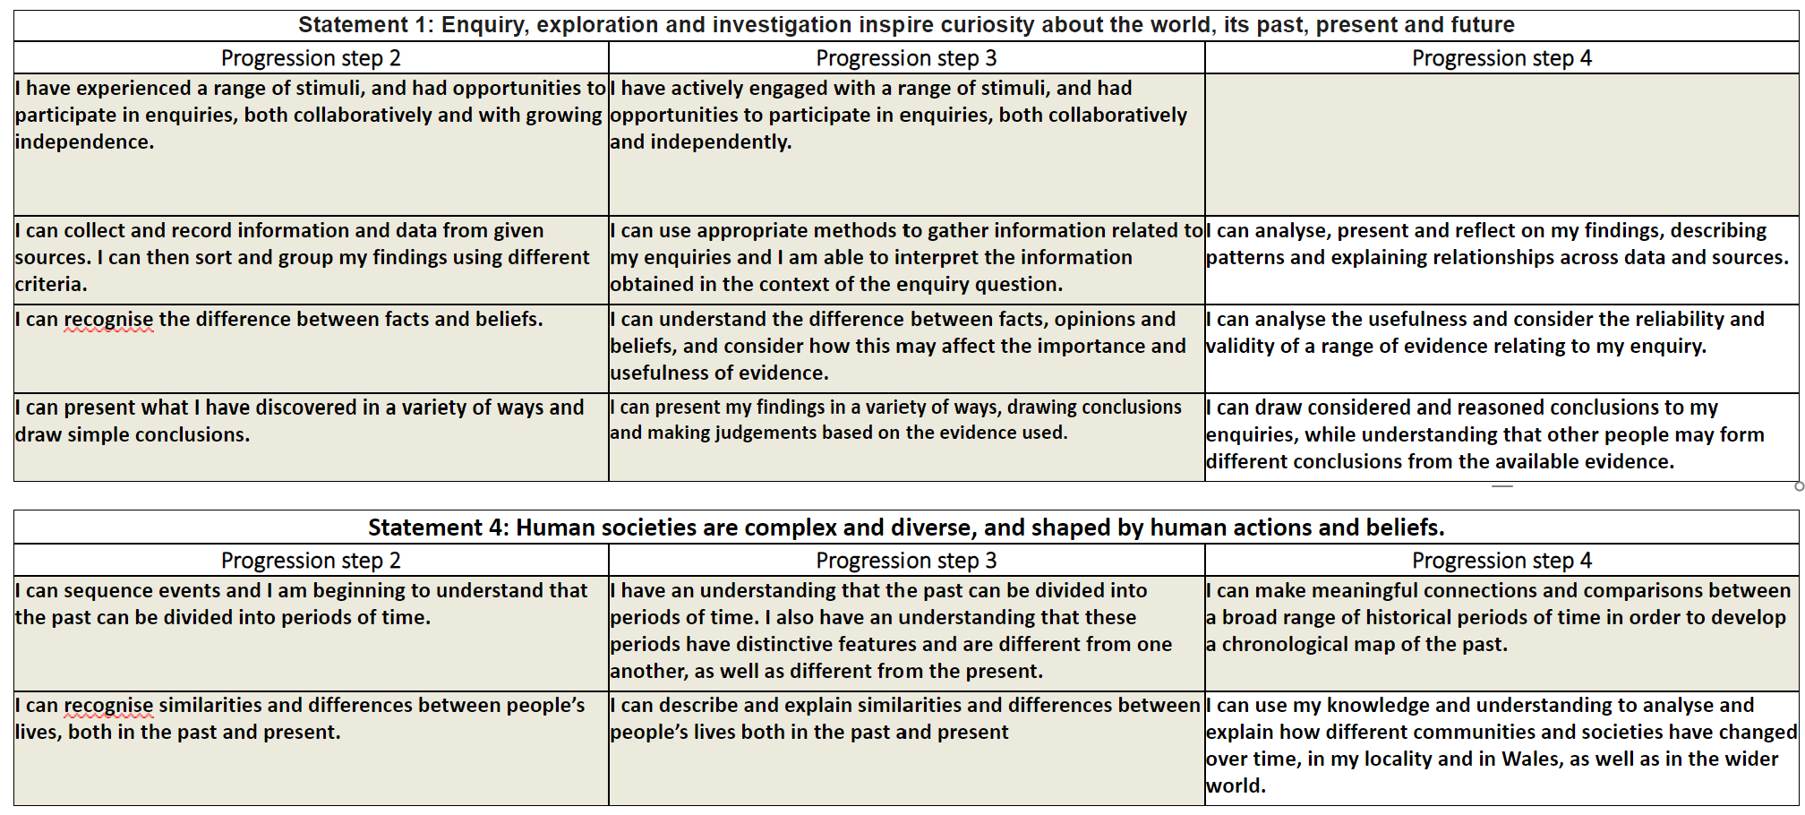
Progression Steps to inform teaching
Progression step 2
Progression step 3
Progression step 4

Slide 7
Prerequisite knowledge
How will skills be taught in this topic?
Most will have started the Cynefin project at the end of year 6 on Lizzie and May
Skills necessary in humanities have been shared with feeder primaries so that they can be addressed where pertinent in year 6.
​Collaborative work on how we evaluate evidence in History using the 5 W’s Who, When, Why, What is in the source, what is missing from the source
Modelling of how to order time – timeline (Chromebook lesson)
Heavily scaffolded support in extended writing co-creating the success criteria – differentiated card sort to support.
Making connections & Authentic Contexts
Connecting with feeder primaries on transition cynefin project.
Connecting with Geography, English and Expressive Arts with cynefin transition project on the Lizzie May tall ship.
Key concepts & learning intentions
Learners should be grounded in an understanding of the identities, landscapes and histories that come together to form their cynefin.
To learn about different types of evidence that help us understand the past and apply this evidence in a local context.
To learn about primary and secondary evidence and evaluate reliability.
To learn about chronology, how we order time using authentic context learning (timeline of the journey of the Lizzie and May)
To become History detectives and use evidence to come up with enquiry questions on who Oitzi the Ice man was.
To use evidence to write an extended piece of writing on why Oitzi the Ice Man is important to Historians.
Key vocabulary
Cynefin
Primary and secondary evidence.
Artefacts, oral, pictoral and written types of evidence
Chronological order

