Slide 1
Curriculum for Wales Scheme of Learning: Humanities
7
Gerald & Princes of Wales

Slide 2
Department Vision
Overall Learning Journey 7-11 Overtime

Slide 3
Statements of What Matters
What matters statement 1: Enquiry, exploration and investigation inspire curiosity about the world, its past, present and future.​
The learners’ journey through this Area will encourage enquiry and discovery, as they are challenged to be curious and to question, to think critically and to reflect upon evidence. An enquiring mind stimulates new and creative thinking, through which learners can gain a deeper understanding of the concepts underpinning humanities, and their application in local, national and global contexts. Such thinking can help learners to understand human experiences and the natural world better.
What matters statement 4: Human societies are complex and diverse, and shaped by human actions and beliefs.​
An appreciation of identity, heritage and cynefin can influence learners emotionally and spiritually, and help build their sense of self and of belonging. Through an understanding of themselves, learners develop their own identity and an awareness of how they, as individuals, can shape the communities in which they live. Consequently, learners will come to realise that the choices we all make, individually and collectively, can have major impacts on society.

Slide 4
Four Purposes
Integral Skills
Ethical, informed citizens who understand and consider the impact of their actions when making choices and acting, and are ready to be citizens of Wales and the world.
Ambitious, capable learners who: set themselves high standards and seek and enjoy challenge and
are building up a body of knowledge with skills to connect and apply that knowledge in different contexts
Enterprising, creative contributors who: connect and apply their knowledge and skills to create ideas, lead and play different roles in teams effectively and responsibly, while expressing ideas and emotions through different media giving of their energy and skills so that other people will benefit.
Personal effectiveness - Encouraging teamwork and being a reliable contributor by organising and carrying out enquiries. Evaluating, justifying and expressing considered responses in a variety of ways
Creativity and innovation - Encouraging the presentation of information and findings in creative and innovative ways, and imagining possible futures based on the evidence.
Planning and organising - Encouraging the planning and organising of investigations, setting aims, objectives and success criteria, gathering and utilising a range of evidence, and reflecting on methods.
Critical thinking and problem-solving - Developing the ability to think analytically and understand the past and present as well as to imagine possible futures.
Cross Curricular Skills
Pedagogical Principles
Literacy
Listening: I can listen to gain different people's views and ideas on various subjects, using them to arrive at my own conclusions.
Reading: I can distinguish between facts/evidence and bias/arguments.
I can summarise, synthesise and analyse information to gain in-depth understanding, e.g. of causes, consequences, patterns, using different sources.
Speaking: I can respond to others' points of view with confidence and sensitivity, summarising and evaluating what I have heard, read or seen.
Writing: I can use a range of connectives specifically when organising my ideas in whole texts for different purposes. I can adapt my writing style, choosing and using the best structures for different contexts and purposes, e.g. to successfully describe, explain, persuade, discuss.
German- Greeting and where you live topic.
Geography – Our local environment
Welsh – Wales and the world.
R.S – Christianity and Islam
Promote critical thinking: learners will understand and be able to explain what Wales was like in 1188 and compare it with any other age in history.
Learners will use the reciprocal reading method to understand and develop knowledge on Llywellyn ap Gruffydd to make an informed decision of who was to blame for the war between England and Wales.
Learner will make connections with terrorist attacks and make a judgement of evidence through sources.
Build on previous knowledge: We will use previous knowledge to explain why Owain Glyndwr rebelled against the English and consider different interpretations of him.
Create authentic contexts for learning: use local and Welsh examples of evidence to enhance discussions on types of evidence.

Slide 5
Principles of Progression
Increasing effectiveness as a learner
Increasing breadth and depth of knowledge
Deepening understanding of the ideas and disciplines within Areas
Learners will have the opportunity to collaboratively analyse evidence and ask increasing sophisticated enquiry questions to form hypothesis and consider two interpretations of Owain Glyndwr.
Learners have various opportunities to read and develop a breadth of knowledge looking at a range of sources, a documentary and PPT slides.
Learners have the opportunity to understand how Welsh princes fought to protect Wales from the English invasions.
Learners can apply new skills learned such as using primary and secondary sources, Interpreting what is in sources of evidence and forming a judgement on the success and failures of the prince.
Looking at different types of evidence primary and secondary
Chronology looking at different periods of time in History
Looking at change and continuity.
Refinement and growing sophistication in the use and application of skills
Making connections and transferring learning into new contexts
Additional notes & Misconceptions
Discussion and evaluation of evidence and being able to make a judgment in the form of a conclusion in an extended writing piece.
Discussion and analysis of sources on the crusades.
-Connections to other curriculum areas (German, geography, R.S and Welsh) and links are encouraged to be identified with learners.
-Links to the school house system and 4 key Welsh heroes when looking at timelines.
- Discussion and written craft of language links to English EG PEEL.
Key Skills learners first come into contact with are
Evaluating the usefulness of evidence
Considering interpretations of Owain Glyndwr.
Extended writing in History (essay)

Slide 6
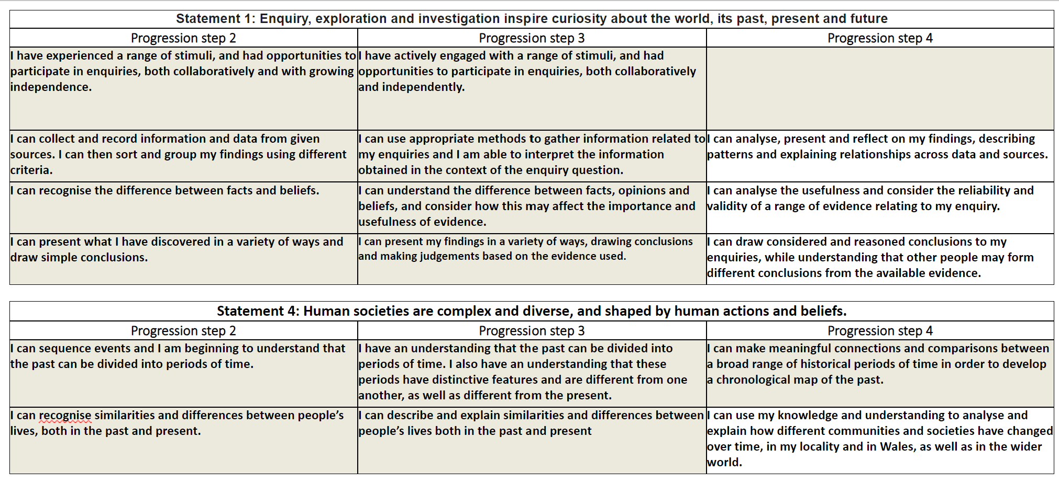
Progression Steps to inform teaching
Progression step 2
Progression step 3
Progression step 4

Slide 7
Prerequisite knowledge
How will skills be taught in this topic?
Learners will have knowledge of the feudal system and castles from the Normans topic.
Primary and secondary evidence
Chronology
​Develop 'Describe' and 'Explain' questions.
Develop source handling skills looking at the reliability of sources.
Making connections & Authentic Contexts
Study of the impact of Edwards conquest on Wales Locally and around North Wales.
Linking Edwards conquest with the building of the British Empire a topic studied in year 8.
Linking Owain Glyndwr's name with institutes in Wales today to show his cultural importance and legacy.
Linking Glyndwr with CQHS links to important Welsh people.
Key concepts & learning intentions
To understand who was to blame for the War between England and Wales.
To explain why Edward I built a iron ring of castles.
To discover who Owain Glyndwr was and why he rebelled against the English in 1400.
To explain why it was difficult to rebel against England under Owain Glyndwr
Key vocabulary
Llywelyn,
heir,
exile,
lordship,
Glyndwr,
Primary and secondary evidence.
Chronology

