Slide 1
Curriculum for Wales Scheme of Learning: Humanities
7
Where in the World?

Slide 2
Department Vision
Overall Learning Journey 7-11 Overtime

Slide 3
Statements of What Matters
Our natural world is diverse and dynamic, influenced by processes and human actions.
What matters statement 1: Enquiry, exploration and investigation inspire curiosity about the world, its past, present and future.​
The learners’ journey through this Area will encourage enquiry and discovery, as they are challenged to be curious and to question, to think critically and to reflect upon evidence. An enquiring mind stimulates new and creative thinking, through which learners can gain a deeper understanding of the concepts underpinning humanities, and their application in local, national and global contexts. Such thinking can help learners to understand human experiences and the natural world better.
Experiencing the wonder of the natural world can contribute to learners’ spiritual development and well-being, and can help to cultivate in them a sense of place and sense of belonging, as embodied in the Welsh word cynefin.
Nurturing curiosity can help learners understand and appreciate how and why places, landscapes and environments in their locality and elsewhere in Wales, as well as in the wider world, are changing. This in turn will enable learners to identify what makes places and spaces distinct, and to develop an awareness of the interconnections between humans and their environment in both contemporary and historical contexts, including in respect of the climate and nature emergency. Consequently, learners will be in a better position to make connections between the past and present, and to consider possible futures.
.
What matters statement 4: Human societies are complex and diverse, and shaped by human actions and beliefs.
An appreciation of identity, heritage and cynefin can influence learners emotionally and spiritually, and help build their sense of self and of belonging. Through an understanding of themselves, learners develop their own identity and an awareness of how they, as individuals, can shape the communities in which they live. Consequently, learners will come to realise that the choices we all make, individually and collectively, can have major impacts on society.

Slide 4
Four Purposes
Integral Skills
Ambitious, capable learners who: set themselves high standards and seek and enjoy challenge and are building up a body of knowledge with skills to connect and apply that knowledge in different contexts
Ethical, informed citizens who:
find, evaluate and use evidence in forming views and engage with contemporary issues based upon their knowledge and values and are knowledgeable about their culture, community, society and the world, now and in the past.
Healthy, confident individuals who:
are building their mental and emotional well-being by developing confidence, resilience empathy, and are ready to lead fulfilling lives as valued members of society.
. Personal effectiveness​
Encouraging teamwork and being a reliable contributor by organising and carrying out enquiries.​
Evaluating, justifying and expressing considered responses in a variety of ways​
Creativity and innovation​
Encouraging the presentation of information and findings in creative and innovative ways, and imagining possible futures based on the evidence.​
Planning and organising​
Encouraging the planning and organising of investigations, setting aims, objectives and success criteria, gathering and utilising a range of evidence, and reflecting on methods.​
Critical thinking and problem-solving​
Developing the ability to think analytically and understand the past and present as well as to imagine possible futures.
Cross Curricular Skills
Pedagogical Principles
Listening: I can listen to gain different people's views and ideas on various subjects, using them to arrive at my own conclusions.
Reading: I can distinguish between facts/evidence to make decisions location information, using different sources.
I can analyse information.
Speaking: I can listen to team members and their opinions when creating collaborative work.
Writing: I can use a range of connectives specifically when organising my ideas in whole texts for different purposes. I can adapt my writing style, choosing and using the best structures for different contexts and purposes, e.g. to successfully describe, explain, persuade, discuss.
Promote critical thinking: learners will work collaboratively to use various sources of information to develop understanding on continents and their location.
Make connections: learners should be able to make links between other subject areas and draw on knowledge to inform and improve their own work.
Build on previous knowledge
Create authentic contexts for learning: using local geography to build upon our place in the world, in relation to continents and oceans.
Work collaboratively to develop map reading skills.

Slide 5
Principles of Progression
Increasing effectiveness as a learner
Increasing breadth and depth of knowledge
Deepening understanding of the ideas and disciplines within Areas
Learners will be building upon their knowledge of continents and oceans.
Learners will develop an understanding in locational knowledge and cynefin.
Learners will have the opportunity to collaboratively problem solve using 4 figure grid references, leading to 6 figure grid references.
Learners have various opportunities to develop a breadth of knowledge about the world looking at continents and oceans, and how to use directions.
Learners will have various opportunities to read and develop their knowledge sourcing information from an atlas and online.
Learners will assess the local environment through maps and school site developing and understanding of the role of a geographer.
Looking at building independent learning
Looking at primary to secondary knowledge
Looking at the differences between the continents
Looking at map reading.
Refinement and growing sophistication in the use and application of skills
Making connections and transferring learning into new contexts
Additional notes & Misconceptions
Being able to confidently lead and/or contribute to a collaborative project on school site.
Learners will be to confidently locate and name continents and oceans.
Learners will be able to apply map reading skills and symbol knowledge on OS Maps.
Connections to other curriculum areas
Numeracy
Literacy
Health and wellbeing
Key aspect of this unit is to link learning from their primary school experience to secondary school.
Learner led Learning
Collaborative learning

Slide 6
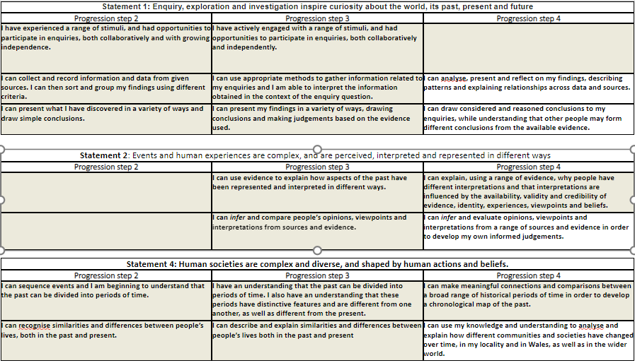
Progression Steps to inform teaching
Progression step 2
Progression step 3
Progression step 4

Slide 7
Prerequisite knowledge
How will skills be taught in this topic?
Lizzie – May work from feeder primary school
Directions such as ordinal compass points
UK map
​
DCF: Be able to collect, enter, organise and analyse data into e.g. tables, charts, databases and spreadsheets.​
Oracy: Present topics and ideas clearly and respond to listeners questions​
Oracy: work collaboratively in pair or team - agree actions and/or reach consensus​
Reading: Actively read a text with fluency and summarise key points of a text​
Writing : Explanation, hypothesis, analysis, evaluation and making a judgement.
Making connections & Authentic Contexts
Use of local area maps in a variety of contexts from OS map, whatthreewords app & school site map
Hand draw their own route to school
Application of grid referencing/direction and location to a port the Lizzie-May visited
Key concepts & learning intentions
To define aspects of geography and cynefin
To explore the questions geographers ask
To assess the school site using geographic skills
To describe location using compass points and distance
To extract information from an Ordnance Survey map
To practise 4-figure grid referencing
To expand to 6-figure grid referencing on OS maps
To design a trip using an OS map demonstrating map skills
Key vocabulary
Continents
Oceans
OS Maps
Compass points
Equator
Longitude
Latitude

