Slide 1
Curriculum for Wales Scheme of Learning: Health and Wellbeing
7-9
Creative

Slide 2
Department Vision
Overall Learning Journey 7-11 Overtime (currently 7-9)
Health and Well-being
Vision
"Our vision for the Health and Well-being AoLE is to create healthy, confident individuals and to empower the learners to thrive physically, mentally, emotionally, and socially in a rapidly changing world.”
We use a curriculum that educates learners about the importance of leading healthy lifestyles and encourages resilience, empathy, decision-making and self-awareness. Through a holistic approach that integrates physical education, health and well-being and food, learners will develop the confidence and competence to make informed decisions that positively influence their own well-being and that of others.
Learning in the classroom and in practical activities aims to develop respect, teamwork, resilience and the wider cross-curricular skills of literacy, numeracy and DCF.
At the heart of the curriculum is the four principles, what matters statements, the principles of progression and individual progression (progression steps) of Curriculum for Wales.
Physical education
In these lessons, learners are encouraged to develop their physical skills, understanding of the benefit of physical activity to leading a healthy lifestyle, resilience and teamwork. They develop fundamental movement skills that can be transferred across different activities and are encouraged to develop communication, thinking skills and be creative.
Health and well-being
In these lessons, learners develop their understanding of the physical, mental and social aspects that promote health and well-being. We aim to enable ethically informed learners that are aware of social influences, that can make informed decisions and understand healthy relationships. Learners are encouraged to be active participants through a range of individual, paired and group activities.
Food
Learners begin to develop the skills that allow them to produce nutritionally valuable meals. They are taught the safe practices that relate to using cooking utensils/appliances and food hygiene. Learners develop the skills and understanding of how to maintain health and well-being through balanced nutrition.
Year 7 | Year 8 zxdvsdvfbe3wrgv | Year 9
Communication | Teamwork | Leadership
Social Skills | Collaboration skills | Collective responsibility skills
Solving basic problems | Solving complex problems | Planning and organisation
Warm up and cool down | Methods of training for health | Testing for fitness
Components of fitness | Methods of training for fitness | Planning for developing fitness
Short term effects of exercise | Long term effects of exercise | Delivering fitness sessions for others
Body control and movement | Use of flight apparatus | Complex skills
Rolling, balancing and flight actions | Onto and over apparatus | Linking skills into sequences
Creating routines | Complex flight actions | Complex routines using a range of apparatus
Effective and constructive feedback | Interpreting feedback to bring about progression | Developing initiative and independence
Rules and regulations of games | Developing control, accuracy and consistency | Developing innovation and understanding of forward thinking in games
Basic knowledge of strategies for success | Knowledge of sport specific tactics for success | Advanced movement patterns for success
Basic attacking principles | Developing attacking principles | Complex attacking principles
Basic defending principles | Developing defending principles | Complex defending principles

Slide 3
Overall Learning Journey 7-11 Overtime (currently 7-9) continued...
Sports we cover | How we assess
Outdoor Adventurous Activities | Communication
Health Fitness and Well being | Develop and apply physical skills
Gymnastics | Understand the links between exercise and health and well being
Badminton | Engage regularly in physical activity
Netball | Show resilience when finding a task difficult
Football | Making connections between different activities
Rugby | Problem solving
Dodgeball | Attitude to learning and engagement in lessons
Handball | Working independently
Volleyball | Decision making
Rounders | Actions and impact
Softball | Knowledge and assessment

Slide 4
Statements of What Matters
Statement
Developing physical health and well-being has lifelong benefits; our decision making impacts the quality of our lives and the lives of others.
Description of Learning
Description of learning/PS:
I can develop and apply a range of skills in familiar, unfamiliar and changing situations, exploring space creatively in response to a variety of stimuli. I can motivate myself to engage confidently in regular physical activity and sport and am aware of my own progress; I can set appropriate goals and plan a course of action to achieve them; I can identify and assess risks and I can take steps to reduce them.

Slide 5
Four Purposes
Integral Skills
Ambitious, capable learners ready to learn throughout their lives
Enterprising, creative contributors, ready to play a full part in life and work
Ethical, informed citizens of Wales and the world
Healthy, confident individuals, ready to lead fulfilling lives as valued members of society
Creativity & innovation: Developing own ideas – using knowledge and understanding of activity skills and rules to develop ever increasingly complex movement and routines
Critical thinking & problem solving: being able to plan a routine based on available equipment, space and time.
Personal effectiveness: Opportunities to evaluate their learning and mistakes; demonstrate initiative and independence. (creating routines and evaluating their success).
Planning & organization: Select, organize and evaluate information relevant to the objective or plan; implement, monitor and evaluate a plan, modifying it as needed and adapting to change. Creating ever more complex routines/sequences that have been modified based on experience.
Cross Curricular Skills
Pedagogical Principles
Literacy: I can listen to, understand and use basic concepts in language, e.g. position and comparison. I can understand and analyse general meaning and implied ideas.
: I can develop and adapt my vocabulary through listening, and use these new words in a variety of situations. I have experienced a range of area of learning and experience/discipline-specific and general academic vocabulary, and can use them in my own communication.
DCF: I can identify and use a range of media and digital devices from familiar experiences. I can reflect on the role of digital media in my life and habits.
Ensures sustained pupil effort to reach high but achievable targets
Encourages learners to take responsibility for their own learning
Employs a broad repertoire of teaching approaches

Slide 6
Principles of Progression
Increasing effectiveness as a learner
Increasing breadth and depth of knowledge
Deepening understanding of the ideas and disciplines within Areas
Moving from teacher led basic movement to creating sequences and routines.
Increasing subject knowledge from basic skills to using more complex actions. Making more complex sequences of movement.
Linking the skills required to their overall impact on health and well-being (particularly strength and flexibility)
Refinement and growing sophistication in the use and application of skills
Making connections and transferring learning into new contexts
Additional notes & Misconceptions
Understanding how to develop other peoples’ health and well-being. Being able to analyse performance to develop one's own and others' physical literacy.
Support for others within group activity.
Connecting creative activities to other physical activities and linking their benefit to health and well-being.

Slide 7
HOW? –Year 7
Physical literacy – skill development; sequencing of movement
HOW? –Year 8
Using physical skills to increase complexity of movement through flight and complexity of sequencing
HOW? –Year 9
Improving their own and others use of physical skills. Developing increased complexity of movement and sequencing.
1. Understanding the building blocks of gymnastics movement. Basic shapes (gymnastics alphabet), tension, strength and resilience. Knowledge of linking movements with fluency. SAFETY/RISKS in gymnastics. Learners describe tension
2. Developing rolling actions – forward, backward, side, log and teddy bear. From simple to more complex e.g. tucked to pike forward roll. Link shapes and rolls.
3. Handstands & other inverted balance, link within sequence. Learners need the opportunity explain how they are linking actions.
4. Cartwheels/flight actions. Link within sequence.
5. PIT STOP- review of skills learned and knowledge of gymnastics norms. (assessment for learning)
6. Creating a floor routine
7. Creating a floor routine
Opportunities to communicate new vocabulary and explain ideas should be given throughout.
1. Revision of skills, knowledge and understanding from prior learning. Introduce spring boards to create flight. (Technique) SAFETY/RISK – IDENTIFY AND ASSESS.
2/3. Use of spring boards to create flight onto and over apparatus (buck, horse, box; tuck, straddle, roll)
4. PIT STOP- review understanding of how flight actions occur, knowledge of vocabulary used.
5/6 Developing more complex flight actions e.g. handspring, somersault, round off, front/back flic.
7. Link a specific flight action with other gymnastics actions into a sequence.
Opportunities to develop basic and more complex skills along-side each other should be given.
Learners should be given opportunities to listen to and use specific language to the activity.
1. Develop the use of higher level/more complex sets of apparatus/skills. Circuit of 5 sets of apparatus of varying degrees of difficulty that include a flight element.
Use two sets to create small sequences containing flight, rolls and balance.
Develop hand-spring as a skill.
2/3/4 – repetition of lesson 1. With a development of hand-springs and somersaults.
5. PIT STOP – have learners used individual sets of apparatus to create mini sequences using flight, rolls and balance?
Have learners developed higher skill sets?
Can learners show knowledge and understanding of how to complete these activities? Teacher questioning
6/7 Create a full routine using the 5 sets of apparatus. Show completed higher set skills.
Learners can explain why they created their sequence using these sets of apparatus

Slide 8
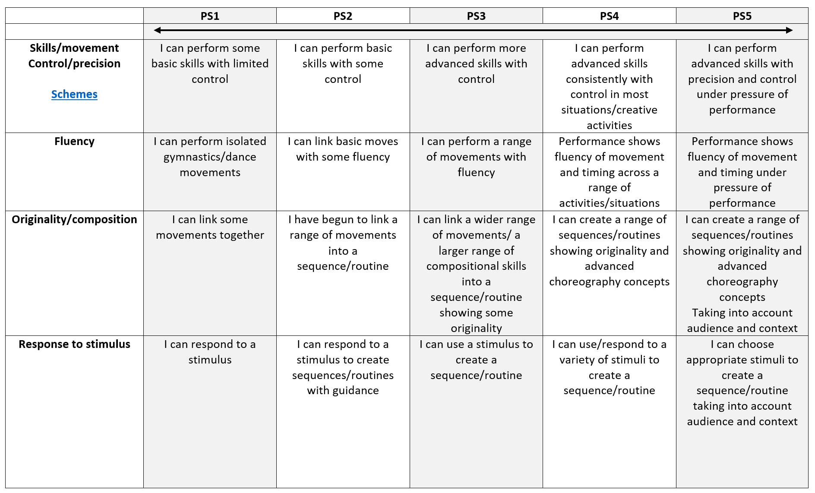
Progression Steps

Slide 9
Progression Steps to inform teaching
Progression step 2
Progression step 3
Progression step 4
I can perform basic skills with some control
I can link basic moves with some fluency
I have begun to link a range of movements into a sequence/routine
I can respond to a stimulus to create sequences/routines with guidance
I can perform more advanced skills with control
I can perform a range of movements with fluency
I can link a wider range of movements/ a larger range of compositional skills into a sequence/routine showing some originality
I can use a stimulus to create a sequence/routine
I can perform advanced skills consistently with control in most situations/creative activities
Performance shows fluency of movement and timing across a range of activities/situations
I can create a range of sequences/routines showing originality and advanced choreography concepts
I can use/respond to a variety of stimuli to create a sequence/routine

Slide 10
Prerequisite knowledge
How will skills be taught in this topic?
Basic physical actions - walk, sprint, jump
Basic shapes in gymnastics.
Understand what flight, rolling and turning are.
Basic knowledge of the body (muscles),
Understand what a stimulus is (even if they do not know the terminology).
Developing and applying physical skills will be taught through gymnastics activities.
Communicating effectively will be developed through paired/group work, Q&A, feedback to peers when analysing performance.
Links will be made to the benefits of gymnastics activities to overall physical health & well-being.
Learners will be encouraged to take part in regular activity. Gymnastics being an example for some to continue participation.
Learners will be encouraged to show resilience when a new skill is being developed and/or when skills are being improved upon.
Making connections & Authentic Contexts
Reference to Welsh gymnasts and sporting centres.
Link to health and well-being for life
Link to Health and well-being lessons
Key concepts & learning intentions
Physical literacy skills - rolls, balances, jumping actions. Vaulting skills.
Sequencing actions to create an extended pattern of movement.
Understand how the activity links to health & well-being
Key vocabulary
Plan, evaluate, analyse
Tension, balance, fluency.
Flight, balance, travel, roll, turn
Mirror, match, motif
Resilience, strength and flexibility

