Slide 1
Curriculum for Wales Scheme of Learning: Health and Wellbeing
7-9
Competitive

Slide 2
Department Vision
Overall Learning Journey 7-11 Overtime (currently 7-9)
Health and Well-being
Vision
"Our vision for the Health and Well-being AoLE is to create healthy, confident individuals and to empower the learners to thrive physically, mentally, emotionally, and socially in a rapidly changing world.”
We use a curriculum that educates learners about the importance of leading healthy lifestyles and encourages resilience, empathy, decision-making and self-awareness. Through a holistic approach that integrates physical education, health and well-being and food, learners will develop the confidence and competence to make informed decisions that positively influence their own well-being and that of others.
Learning in the classroom and in practical activities aims to develop respect, teamwork, resilience and the wider cross-curricular skills of literacy, numeracy and DCF.
At the heart of the curriculum is the four principles, what matters statements, the principles of progression and individual progression (progression steps) of Curriculum for Wales.
Physical education
In these lessons, learners are encouraged to develop their physical skills, understanding of the benefit of physical activity to leading a healthy lifestyle, resilience and teamwork. They develop fundamental movement skills that can be transferred across different activities and are encouraged to develop communication, thinking skills and be creative.
Health and well-being
In these lessons, learners develop their understanding of the physical, mental and social aspects that promote health and well-being. We aim to enable ethically informed learners that are aware of social influences, that can make informed decisions and understand healthy relationships. Learners are encouraged to be active participants through a range of individual, paired and group activities.
Food
Learners begin to develop the skills that allow them to produce nutritionally valuable meals. They are taught the safe practices that relate to using cooking utensils/appliances and food hygiene. Learners develop the skills and understanding of how to maintain health and well-being through balanced nutrition.
Year 7 | Year 8 zxdvsdvfbe3wrgv | Year 9
Communication | Teamwork | Leadership
Social Skills | Collaboration skills | Collective responsibility skills
Solving basic problems | Solving complex problems | Planning and organisation
Warm up and cool down | Methods of training for health | Testing for fitness
Components of fitness | Methods of training for fitness | Planning for developing fitness
Short term effects of exercise | Long term effects of exercise | Delivering fitness sessions for others
Body control and movement | Use of flight apparatus | Complex skills
Rolling, balancing and flight actions | Onto and over apparatus | Linking skills into sequences
Creating routines | Complex flight actions | Complex routines using a range of apparatus
Effective and constructive feedback | Interpreting feedback to bring about progression | Developing initiative and independence
Rules and regulations of games | Developing control, accuracy and consistency | Developing innovation and understanding of forward thinking in games
Basic knowledge of strategies for success | Knowledge of sport specific tactics for success | Advanced movement patterns for success
Basic attacking principles | Developing attacking principles | Complex attacking principles
Basic defending principles | Developing defending principles | Complex defending principles

Slide 3
Overall Learning Journey 7-11 Overtime (currently 7-9) continued...
Sports we cover | How we assess
Outdoor Adventurous Activities | Communication
Health Fitness and Well being | Develop and apply physical skills
Gymnastics | Understand the links between exercise and health and well being
Badminton | Engage regularly in physical activity
Netball | Show resilience when finding a task difficult
Football | Making connections between different activities
Rugby | Problem solving
Dodgeball | Attitude to learning and engagement in lessons
Handball | Working independently
Volleyball | Decision making
Rounders | Actions and impact
Softball | Knowledge and assessment

Slide 4
Statements of What Matters
What matters statements
Developing physical health and well-being has lifelong benefits; Healthy relationships are fundamental to our well-being. Our decision making impacts on the quality of our lives and the lives of others.
Description of Learning
Description of learning/PS:
I can develop and apply a range of skills in familiar, unfamiliar and changing situations, exploring space creatively in response to a variety of stimuli. I can motivate myself to engage confidently in regular physical activity and sport, and am aware of my own progress; I can set appropriate goals and plan a course of action to achieve them; I can identify and assess risks and I can take steps to reduce them.

Slide 5
Four Purposes
Integral Skills
Ambitious, capable learners ready to learn throughout their lives
Enterprising, creative contributors, ready to play a full part in life and work
Ethical, informed citizens of Wales and the world
Healthy, confident individuals, ready to lead fulfilling lives as valued members of society
Creativity & innovation: Developing own ideas – using knowledge and understanding of activity skills and rules to develop ever increasingly complex movement and strategies.
Critical thinking & problem solving: being able to change strategy according to score and time phase of a game.
Personal effectiveness: Opportunities to evaluate their learning and mistakes; demonstrate initiative and independence. Opportunities to be a leader/official/player.
Planning & organization: Planning a strategy to win a game. Changing the strategy if it isn’t working.
Cross Curricular Skills
Pedagogical Principles
Literacy: I can listen to, understand and use basic concepts in language, e.g. position and comparison. I can understand and analyse general meaning and implied ideas.
I can develop and adapt my vocabulary through listening and use these new words in a variety of situations. I have experienced a range of area of learning and experience/discipline-specific and general academic vocabulary and can use them in my own communication.
I have experienced a range of area of learning and experience/discipline-specific and general academic vocabulary and can use them in my own communications.
Ensures sustained pupil effort to reach high but achievable targets
Encourages learners to take responsibility for their own learning
Employs a broad repertoire of teaching approaches.
Making it real

Slide 6
Principles of Progression
Increasing effectiveness as a learner
Increasing breadth and depth of knowledge
Deepening understanding of the ideas and disciplines within Areas
Moving from teacher led basic skills and strategies to more complex ones. Choosing appropriate tactics/strategies and know when to change them.
Increasing subject knowledge from basic skills to complex ones. Deepening understanding of strategies and how to work with others
Linking the activities to their overall impact on health and well-being; social, physical and mental.
Refinement and growing sophistication in the use and application of skills
Making connections and transferring learning into new contexts
Additional notes & Misconceptions
Understanding how to develop their own skills in activities as well as other peoples.
Understand the transferable skills across activities and their links to continued lifelong activity.

Slide 7
HOW? –Year 7
Basic physical skill development Basic knowledge of strategies and tactics
Rules and norms of activities
HOW? –Year 8
Gaining more control, developing accuracy and consistency.
Increasing knowledge of tactics and strategies
Developing communication in pairs and teams.
HOW? –Year 9
Advancing tactical awareness, positional play. Developing more advanced practical skills along with revisiting prior learning. Leadership.
Invasion games (netball, football, rugby, dodgeball, handball)
1. Assessing skill level (baseline)
Assess knowledge and understanding. Teacher questioning
2. Developing passing/receiving skills.
3. Develop dribbling/travelling with a ball
4. Being effective as a player Learners can demonstrate or explain how each skill builds to an effective performance.
5. PIT STOP- applying skills, showing communication skills and knowledge of basic tactics/strategies.
6. Understanding rules
7. Applying prior knowledge into games situations.
Opportunities should be given to
developing speaking and literacy skills, developing independence and understanding connections to health.
Invasion games (netball, football, rugby, dodgeball, handball)
1. Assessing prior knowledge, understanding and skill level. Looking for leadership and communication.
2/3 Increasing the breadth and depth of knowledge/physical skill e.g. passing & receiving, travelling and scoring.
4. PIT STOP - applying skills, showing communication skills and knowledge of basic tactics/strategies.
5/6/7. Increasing the knowledge of tactics and strategies – possession, defence, attack, width, depth.
Opportunities should be given to
developing speaking and literacy skills, developing independence and understanding connections to health.
Invasion games (netball, football, rugby, dodgeball, handball)
1. Assessing prior knowledge, understanding, skill level. Communication and leadership skills.
2/3/4. Increasing the effectiveness of physical skills. Developing breadth of knowledge of tactical awareness. Developing leadership skills. (increase opportunities for leading within activities, captain, referee, coach)
5. PIT STOP- assessing the use of more advanced skills within the appropriate activity e.g. rucking, scrummaging, tackling; passing, dribbling, set plays in football/netball/basketball/handball.
Assessment of speaking and listening skills within a game.
6/7. Further develop strategies and skill through game play.

Slide 8
HOW? –Year 7
Problem solving, team building and bouldering.
HOW? –Year 8
Improving components of fitness (training methods)
HOW? –Year 9
Developing team skills – communication, leadership, relationships and decision making. SPORT ED’
Net games (badminton, table-tennis, volleyball)
1. Assessing skill level (baseline)
Assess knowledge and understanding.
2/3/4. Develop basic actions of serve, clear, dropshot; serve, forehand/backhand drive; serve, dig, set, spike.
5. PIT STOP- applying skills, showing communication skills in pairs/teams and knowledge of basic tactics/strategies.
6. Understanding and using basic team positioning/rules
7. Applying prior knowledge into games situations
Gaining more control, developing accuracy and consistency.
Increasing knowledge of tactics and strategies
1. Assessing prior knowledge and understanding. Learning, knowledge and skill level.
2. Develop accuracy, consistency and use of basic skills learned in Year 7.
3/4/5. Increasing breadth of skills – backhand shot development, direction of shots (depth and width); top spin/backspin (forehand/backhand); dig, set, spike at the net (width and depth of play).
Develop more advanced tactics/team play where appropriate.
6/7 ASSESSMENT – no pit stop – on going formative assessment through game play. Develop communication in pairs/teams. Developing understanding of positioning in pairs/teams.
Advancing tactical awareness, positional play. Developing more advanced practical skills along with revisiting prior learning.
1. Assessing prior knowledge and understanding. Learning, knowledge and skill level.
2/3/4. Developing knowledge and understanding of when and how to use prior skills learned. Game awareness (developing depth of understanding and breadth of strategy).
5.PIT STOP – the use of skills and strategy in a game situation.
6/7. Using strategy and continued development of skill.

Slide 9
HOW? –Year 7
Problem solving, team building and bouldering.
HOW? –Year 8
Improving components of fitness (training methods)
HOW? –Year 9
Developing team skills – communication, leadership, relationships and decision making. SPORT ED’
Striking (rounders, softball, cricket, stool ball)
Athletics-resilience
1. Assessing skill level (baseline)
Assess knowledge and understanding.
2/3/4. Developing understanding of rules of games. Develop batting, catching, throwing, retrieving.
5. PIT STOP-Use skills and show understanding in a game situation.
6/7. Develop skills and improve understanding/knowledge of tactics in games.
Gaining more control, developing accuracy and consistency.
Increasing knowledge of tactics and strategies
1. Assessing prior knowledge and understanding. Learning, knowledge and skill level.
2/3/4. Reinforce understanding of rules.
Improve accuracy of batting, catching and throwing. Improve retrieval skills. Develop basic -more advanced strategies/tactics for winning.
5. PIT STOP- through games, see an understanding of rules, show development in accuracy of skills.
6/7. Embed and further develop skills and understanding of strategy. Develop communication in the game to improve outcomes.
Advancing tactical awareness, positional play. Developing more advanced practical skills along with revisiting prior learning.
1. Assessing prior knowledge and understanding. Learning, knowledge and skill level.
2/3/4. Develop a broader range of batting and throwing skills – range of shots; short under arm/long overarm throw and when to use them. Understanding of where it is appropriate to throw a caught or retrieved ball.
5. PIT STOP- sending the ball to the correct place when fielding. Using a range of shots to outwit fielders.
6/7. Develop leadership through tactical development in games situations.

Slide 10
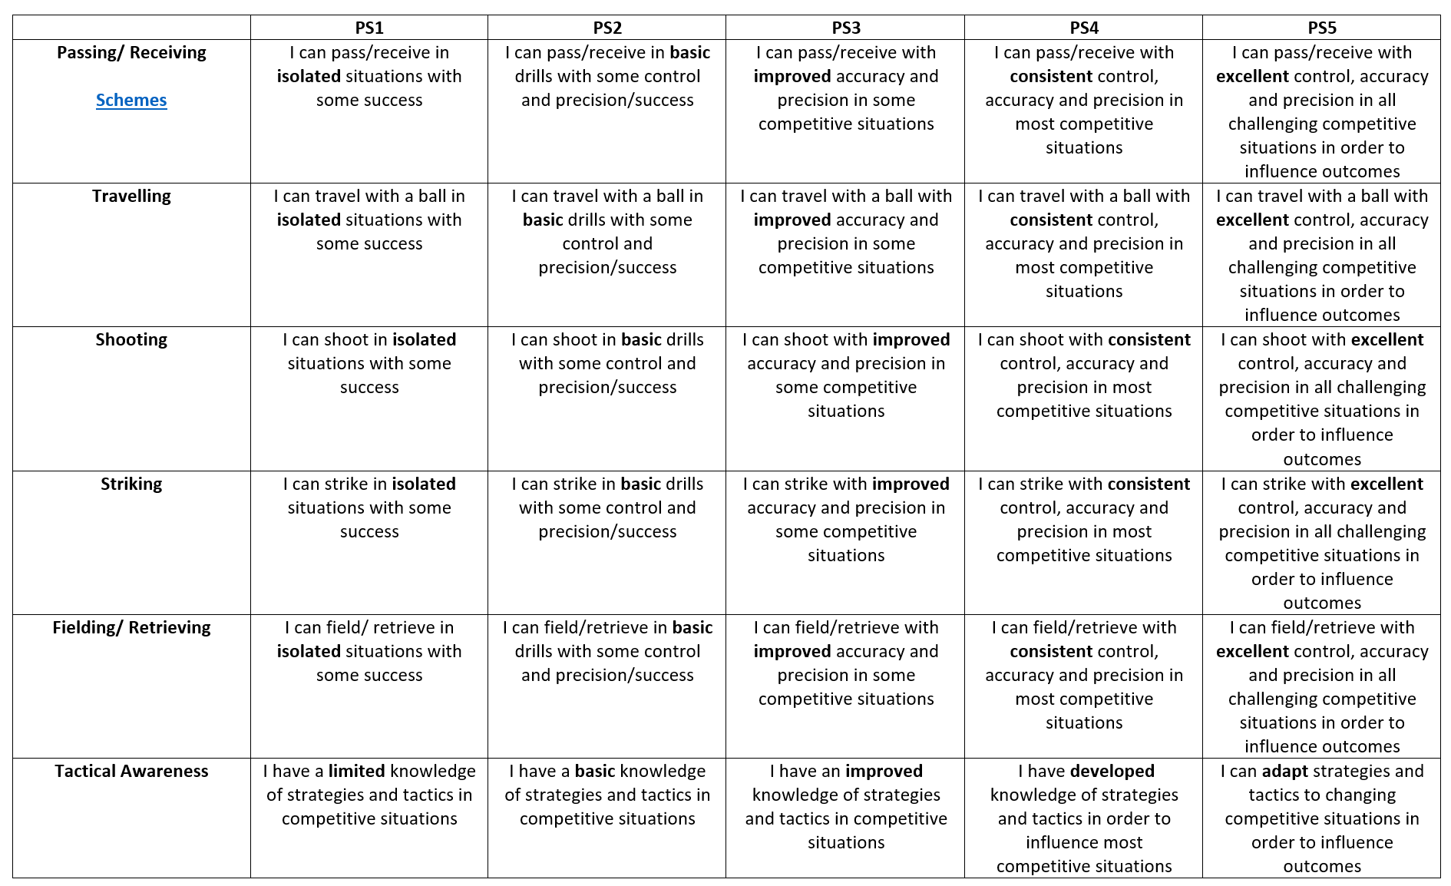
Progression Steps (adapted)

Slide 11
Progression Steps to inform teaching (adapted)
Progression step 2
Progression step 3
Progression step 4
I can pass/receive in basic drills with some control and precision/success
I can travel with a ball in basic drills with some control and precision/success
I can shoot in basic drills with some control and precision/success
I can strike in basic drills with some control and precision/success
I can field/retrieve in basic drills with some control and precision/success
I have a basic knowledge of strategies and tactics in competitive situations
I can pass/receive with improved accuracy and precision in some competitive situations
I can travel with a ball with improved accuracy and precision in some competitive situations
I can shoot with improved accuracy and precision in some competitive situations
I can strike with improved accuracy and precision in some competitive situations
I can field/retrieve with improved accuracy and precision in some competitive situations
I have an improved knowledge of strategies and tactics in competitive situations
I can pass/receive with consistent control, accuracy and precision in most competitive situations
I can travel with a ball with consistent control, accuracy and precision in most competitive situations
I can shoot with consistent control, accuracy and precision in most competitive situations
I can strike with consistent control, accuracy and precision in most competitive situations
I can field/retrieve with consistent control, accuracy and precision in most competitive situations
I have developed knowledge of strategies and tactics in order to influence most competitive situations

Slide 12
Prerequisite knowledge
How will skills be taught in this topic?
Catching, throwing, running, jumping skills
Coordination
Knowledge of competitive activities
Participation in physical activity.
Communicating effectively with others in pair and group activities.
Develop and apply physical skills through competitive activities.
Understand the links between participating in these activities and the benefits to health & well-being
Engage regularly in physical activity
Show resilience when finding a task or activity difficult.
Making connections & Authentic Contexts
Reference to Welsh sports people and sporting centres.
Key concepts & learning intentions
Improving physical literacy skills to improve outcomes in competitive activities.
Developing tactical understanding and awareness within competitive activities.
Developing communication skills to improve outcomes in games activities. Developing the skill of communication so that it can be used effectively outside of physical education.
Key vocabulary
Passing/ Receiving, travelling, Shooting, Striking, Fielding/ Retrieving, Tactical Awareness
Precision, accuracy, excellence
Coordination, control, fluency
Communication, teamwork, resilience, leadership

