Slide 1
Curriculum for Wales Scheme of Learning: Health and Wellbeing
7-9
OAA

Slide 2
Department Vision
Overall Learning Journey 7-11 Overtime (currently 7-9)
Health and Well-being
Vision
"Our vision for the Health and Well-being AoLE is to create healthy, confident individuals and to empower the learners to thrive physically, mentally, emotionally, and socially in a rapidly changing world.”
We use a curriculum that educates learners about the importance of leading healthy lifestyles and encourages resilience, empathy, decision-making and self-awareness. Through a holistic approach that integrates physical education, health and well-being and food, learners will develop the confidence and competence to make informed decisions that positively influence their own well-being and that of others.
Learning in the classroom and in practical activities aims to develop respect, teamwork, resilience and the wider cross-curricular skills of literacy, numeracy and DCF.
At the heart of the curriculum is the four principles, what matters statements, the principles of progression and individual progression (progression steps) of Curriculum for Wales.
Physical education
In these lessons, learners are encouraged to develop their physical skills, understanding of the benefit of physical activity to leading a healthy lifestyle, resilience and teamwork. They develop fundamental movement skills that can be transferred across different activities and are encouraged to develop communication, thinking skills and be creative.
Health and well-being
In these lessons, learners develop their understanding of the physical, mental and social aspects that promote health and well-being. We aim to enable ethically informed learners that are aware of social influences, that can make informed decisions and understand healthy relationships. Learners are encouraged to be active participants through a range of individual, paired and group activities.
Food
Learners begin to develop the skills that allow them to produce nutritionally valuable meals. They are taught the safe practices that relate to using cooking utensils/appliances and food hygiene. Learners develop the skills and understanding of how to maintain health and well-being through balanced nutrition.
Year 7 | Year 8 zxdvsdvfbe3wrgv | Year 9
Communication | Teamwork | Leadership
Social Skills | Collaboration skills | Collective responsibility skills
Solving basic problems | Solving complex problems | Planning and organisation
Warm up and cool down | Methods of training for health | Testing for fitness
Components of fitness | Methods of training for fitness | Planning for developing fitness
Short term effects of exercise | Long term effects of exercise | Delivering fitness sessions for others
Body control and movement | Use of flight apparatus | Complex skills
Rolling, balancing and flight actions | Onto and over apparatus | Linking skills into sequences
Creating routines | Complex flight actions | Complex routines using a range of apparatus
Effective and constructive feedback | Interpreting feedback to bring about progression | Developing initiative and independence
Rules and regulations of games | Developing control, accuracy and consistency | Developing innovation and understanding of forward thinking in games
Basic knowledge of strategies for success | Knowledge of sport specific tactics for success | Advanced movement patterns for success
Basic attacking principles | Developing attacking principles | Complex attacking principles
Basic defending principles | Developing defending principles | Complex defending principles

Slide 3
Overall Learning Journey 7-11 Overtime (currently 7-9) continued...
Sports we cover | How we assess
Outdoor Adventurous Activities | Communication
Health Fitness and Well being | Develop and apply physical skills
Gymnastics | Understand the links between exercise and health and well being
Badminton | Engage regularly in physical activity
Netball | Show resilience when finding a task difficult
Football | Making connections between different activities
Rugby | Problem solving
Dodgeball | Attitude to learning and engagement in lessons
Handball | Working independently
Volleyball | Decision making
Rounders | Actions and impact
Softball | Knowledge and assessment

Slide 4
Statements of What Matters
What matters statement
Developing physical health and well-being has lifelong benefits; our decision making impacts the quality of our lives and the lives of others.
Description of Learning
Description of learning/PS:
I can develop and apply a range of skills in familiar, unfamiliar and changing situation. I can motivate myself to engage confidently in regular physical activity and sport, and am aware of my own progress; I can set appropriate goals and plan a course of action to achieve them; I can ask for help when I need it from people I trust. I can set appropriate goals. I can understand that decisions can be made individually and collectively, and that they can be influenced by a range of factors.

Slide 5
Four Purposes
Integral Skills
Healthy, Confident Individuals
Ambitious, capable learners
Enterprising, creative
Creativity & innovation: Developing own ideas – using knowledge and understanding of activity skills and rules to develop social skills (speaking, listening, team work)
Critical thinking & problem solving: being able to plan actions to create success.
Personal effectiveness: Opportunities to evaluate their learning and mistakes; demonstrate initiative and independence. (evaluating plans/actions and altering them accordingly; being resilient when facing difficulty)
Planning & organization: Select, organise and evaluate information relevant to the objective or plan; implement, monitor and evaluate a plan, modifying it as needed and adapting to change. In Sport Ed’ learners will plan activities then evaluate then modify plans for future sessions.
Cross Curricular Skills
Pedagogical Principles
Literacy: I can listen to and respond to others with questions, comments and suggestions in order to develop collaborative talk and reach compromise/consensus.
I can listen to and consider the relevance and significance of information and ideas presented to me. I can listen to others’ ideas/presentations, and understand that they may have a different perspective to my own, in order to respond appropriately. I can listen to gain different people's views and ideas on various subjects, using them to arrive at my own conclusions. I have experienced a range of area of learning and experience/discipline-specific and general academic vocabulary, and can use them in my own communication.
I can speak clearly, selecting and adapting my language appropriately for a range of audiences and purposes, conveying meaning effectively to the audience.
I can reflect on my use of strategies to improve the quality, accuracy and effects of my spoken communication, including in formal situations.
I have experienced a range of area of learning and experience/discipline-specific and general academic vocabulary, and can use them in my own communication.
I can organise talk so that different audiences in different contexts can follow what is being said, including using formal language.
I can contribute to group discussion in different roles, taking responsibility for completing the task well.
I have experienced speaking with different people in a variety of authentic contexts.
I can respond to others’ points of view by seeking clarity, summarising and explaining what I have heard, read or see
an collect data to answer posed questions. I can draw conclusions from data and recognise that some conclusions may be misleading or uncertain.
Ensures sustained pupil effort to reach high but achievable targets
Encourages learners to take responsibility for their own learning
Employs a broad repertoire of teaching approaches
Promote problem solving, creative and critical thinking
Encourage collaboration

Slide 6
Principles of Progression
Increasing effectiveness as a learner
Increasing breadth and depth of knowledge
Deepening understanding of the ideas and disciplines within Areas
Moving from teacher led instruction through to pairs, teams and independent learning (particularly in Sport Ed’)
Increasing subject knowledge from basic skills to using more complex actions. Increasing the range of language used and communication skills
Linking the skills required to their overall impact on health and well-being (working with others as teams of people)
Refinement and growing sophistication in the use and application of skills
Making connections and transferring learning into new contexts
Additional notes & Misconceptions
Understanding how to develop other peoples’ health and well-being through aiding participation.
Support for others within group activity as per competitive games. Transferring communication skills.

Slide 7
HOW? –Year 7
Problem solving, team building and bouldering.
HOW? –Year 8
Problem solving, team building and bouldering.
HOW? –Year 9
Developing team skills – communication, leadership, relationships and decision making. SPORT ED’
1.Introduction to bouldering –
Warm ups
Safety
Paired working (communication and support)
Types of foot work/ hand holds; when to use them
2. Decision making – learners choosing appropriate routes/difficulty based on ability.
3. Individual challenges on the wall. (Listening skills-follow instructions to the letter, using language clearly) partner directs the climber on routes that they think their partner can do.
4-6/7 Problem solving
A range of problem solving activities that involve pairs and teams, suitable for the ability range within the group.
The focus is on communication and sharing ideas. Listening to others and being open to other’s opinions. Learners should plan their approach to an activity and be creative in their approach to them.
1. Re-cap safety, warm up and holds. Assess ability of the group.
Individual challenges – using three colours, two colours, one colour.
2. Team challenges- keeping team members, against the clock, against a team
3. Individual challenges – setting targets for themselves – time, number of foot holds, number of hand holds
4-6/7 Problem solving
A range of problem solving activities that involve pairs and teams, suitable for the ability range within the group.
The focus is on communication and sharing ideas. Listening to others and being open to other’s opinions. Learners should plan their approach to an activity and be creative in their approach to them.
Learners should increase their depth of knowledge and transfer learning from the previous year. Increase resilience to overcome failure
1. Group organisation – roles (Leader (captain), equipment manager, drill coach, warm up coach, official, players). Set ground rules. Organise the roles for each week. Each learner must take one role other than player for one session.
Leader/manager – communication, overview, discipline, game strategy.
Drill coach- communication with teacher for the drill and participants.
Equipment manager – organization and communication with drill coach
Official – communicates with participants and managers.
Warm up coach – communicates with participants and plans the warmup.
Participants – communicate with each other and the other roles…
Introduce the equipment they will have.

Slide 8
HOW? –Year 7
Problem solving, team building and bouldering.
HOW? –Year 8
Problem solving, team building and bouldering.
HOW? –Year 9
Developing team skills – communication, leadership, relationships and decision making. SPORT ED’
Examples of activities
SHEEP SHEPARD / OBSTICAL COURSE
HOOPS
DRAIN PIPES
DRAWING
Examples of activities
BENCH
BLINDFOLD MINESWEEPER
DRAWING
HUMAN KNOT
DRAINPIPES
CLIMBING WALL CHALLENGE
se their depth of knowledge and transfer learning from the previous year. Increase resilience to overcome failure
Team building exercise.
2-7. Each week the learners take their roles for that week. The skills/drills coach communicates with the teacher who demonstrates the drill. The warm up coach sets up and carries out a warm up.
The equipment manager chooses and supplies the correct equipment for the group. The manager ensures all activities are taking place and is responsible for discipline and time. They also talk to the teacher at the end about how the session has gone, positives, things to work on, discipline and match result.
EACH session has a warm up, a skill/drill element and game.
No PIT STOP. On-going feedback from learners to teachers and vice-versa. Feed forward comes from the teacher after each sessions feedback from learners.

Slide 9
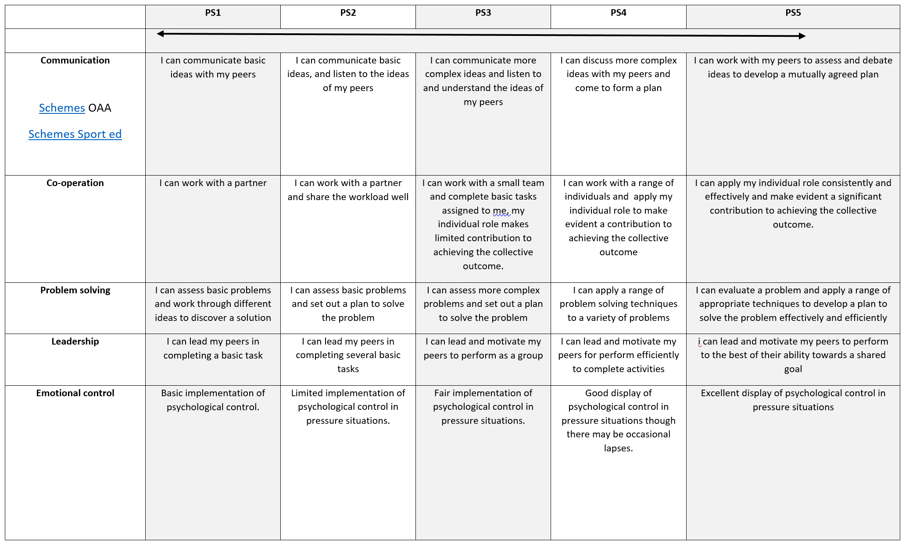
Progression Steps

Slide 10
Progression Steps to inform teaching
Progression step 2
Progression step 3
Progression step 4
I can communicate basic ideas, and listen to the ideas of my peers
I can work with a partner and share the workload well
I can assess basic problems and set out a plan to solve the problem
I can lead my peers in completing several basic tasks
Limited implementation of psychological control in pressure situations.
I can communicate more complex ideas and listen to and understand the ideas of my peers
I can work with a small team and complete basic tasks assigned to me, my individual role makes limited contribution to achieving the collective outcome.
I can assess more complex problems and set out a plan to solve the problem
I can lead and motivate my peers to perform as a group
Fair implementation of psychological control in pressure situations.
I can discuss more complex ideas with my peers and come to form a plan
I can work with a range of individuals and apply my individual role to make evident a contribution to achieving the collective outcome
I can apply a range of problem solving techniques to a variety of problems
I can lead and motivate my peers for perform efficiently to complete activities
Good display of psychological control in pressure situations though there may be occasional lapses.

Slide 11
Prerequisite knowledge
How will skills be taught in this topic?
Communication skills, including listening.
Working with others.
Communicating effectively with others in pair and group activities
Develop and apply physical skills through bouldering, problem solving and sport ed’ activities.
Understand the links between participating in these activities and the benefits to health & well-being
Engage regularly in physical activity
Show resilience when finding a task or activity difficult.
Making connections & Authentic Contexts
Links to HWB lessons
Links to Welsh sport
Links to local/national venues andcentres.
Key concepts & learning intentions
Developing communication through problem solving and Sports ed’ (learner led lessons)
Developing leadership through problem solving and Sports ed’ (learner led lessons).
Developing planning skills to increase the likelihood of positive outcomes and progress.
Developing the concept of risk management along side the concept of taking risks (resilience) to improve outcomes.
Key vocabulary
Bouldering, problem solving, Sports education
Leadership, roles, responsibilities
Communication
Planning
Resilience

